Slide 1

NeuSym-RAG: Hybrid Neural Symbolic Retrieval with Multiview Structuring for PDF Question Answering
Ruisheng Cao*, Hanchong Zhang*, Tiancheng Huang*, Zhangyi Kang, Yuxin Zhang, Liangtai Sun, Hanqi Li, Yuxun Miao, Shuai Fan, Lu Chen, and Kai Yu
Notes:
Some tips

Slide 2
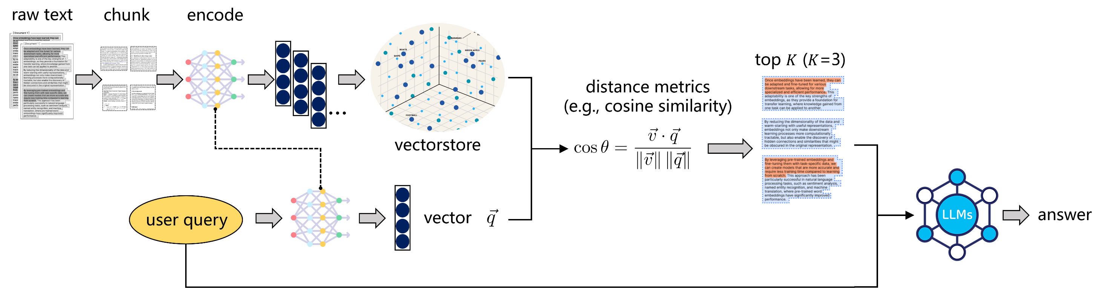
Motivation
Retrieval-based Question Answering System
single knowledge source

Slide 3
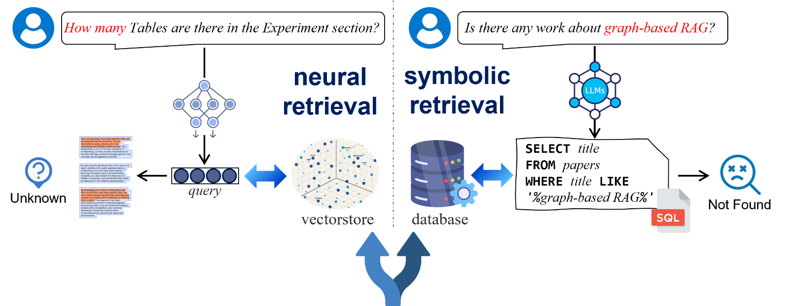
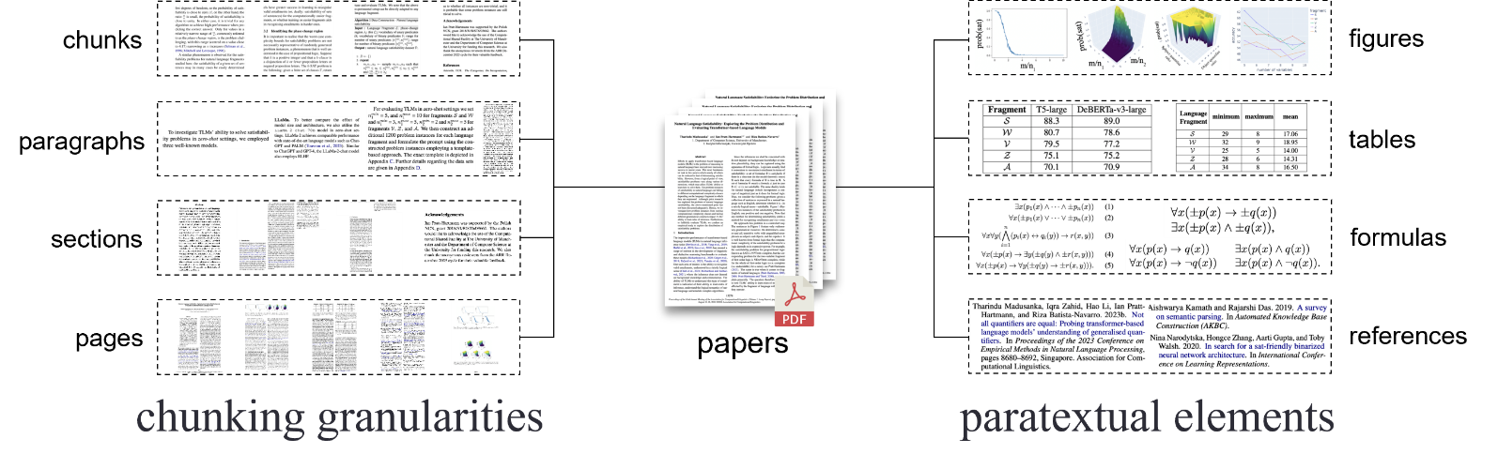
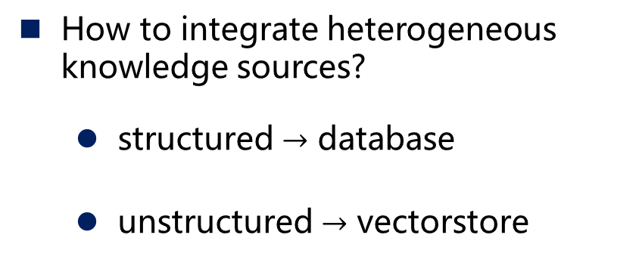
Motivation
How to segment and organize multiple views?
How to integrate heterogeneous knowledge sources?
structured $→$ database
unstructured $→$ vectorstore

Slide 4
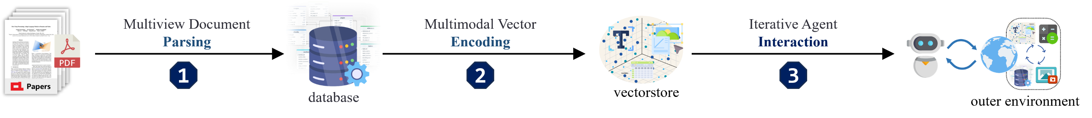
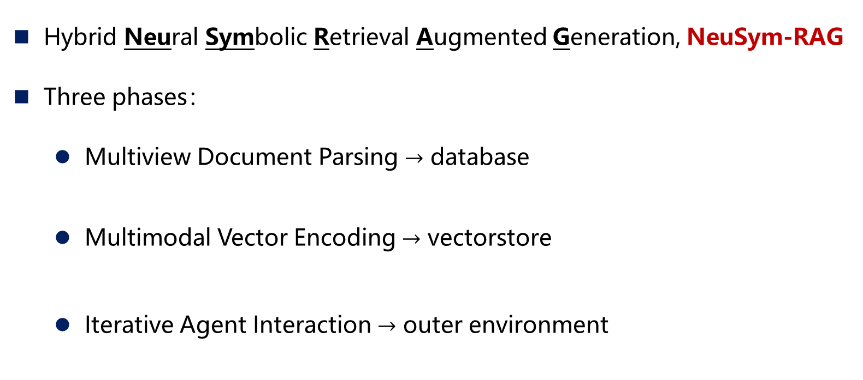
Method
Hybrid Neural Symbolic Retrieval Augmented Generation, NeuSym-RAG
Three phases：
Multiview Document Parsing $→$ database
Multimodal Vector Encoding $→$ vectorstore
Iterative Agent Interaction $→$ outer environment
Multiview knowledge extraction
Organization of heterogeneous knowledge sources
Multimodal knowledge encoding
Unified planning and scheduling of heterogeneous knowledge sources

Slide 5
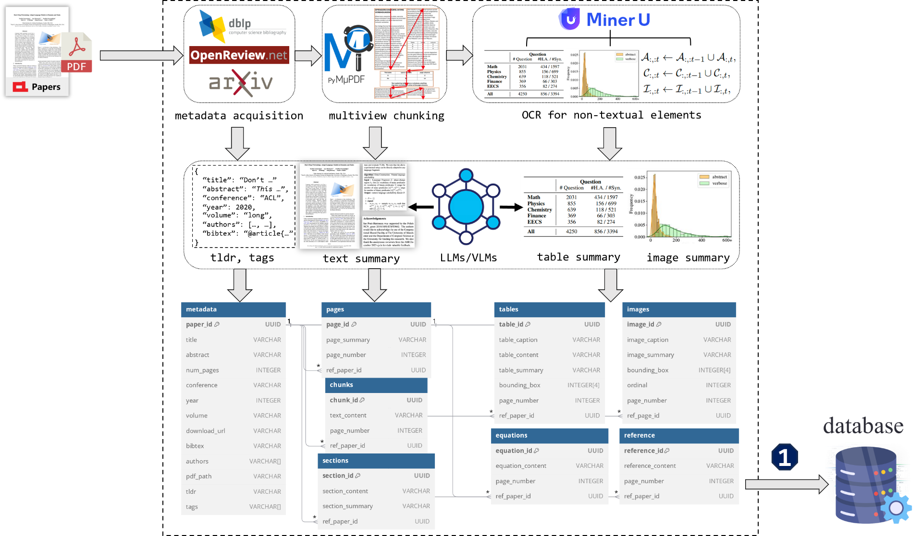
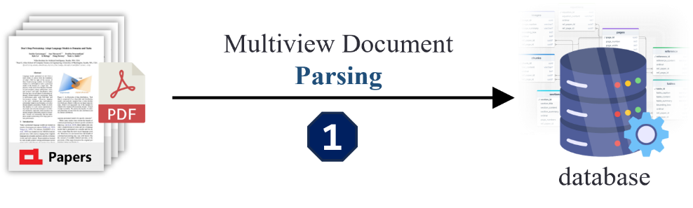
Method
Multiview knowledge extraction
Phase 1：Multiview Document Parsing → database
Scholar API
Text segmentation
Paratextual extraction
LLM-based summarization

Slide 6
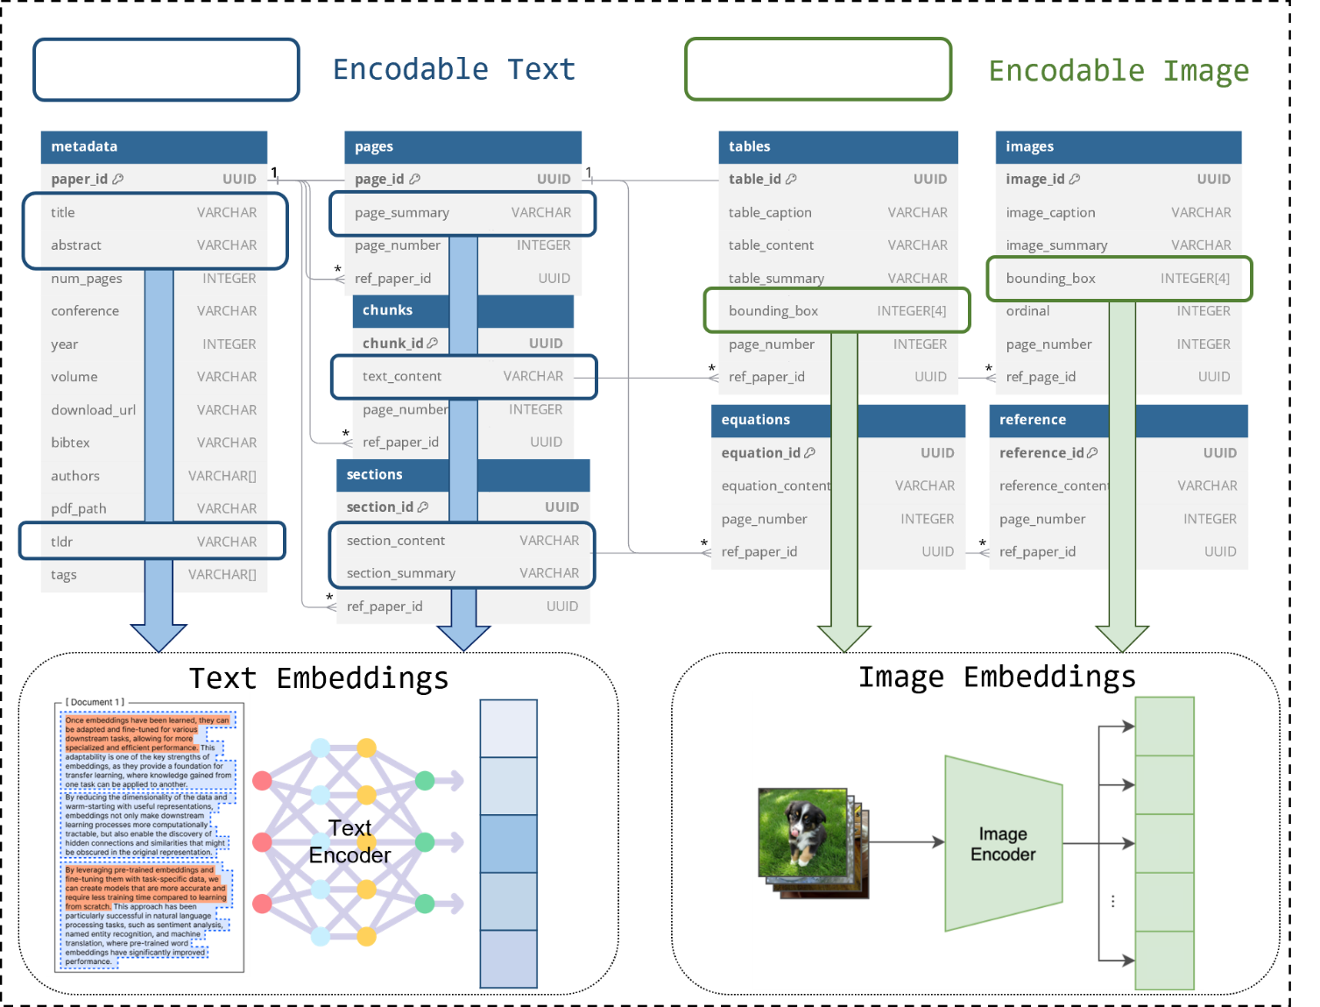
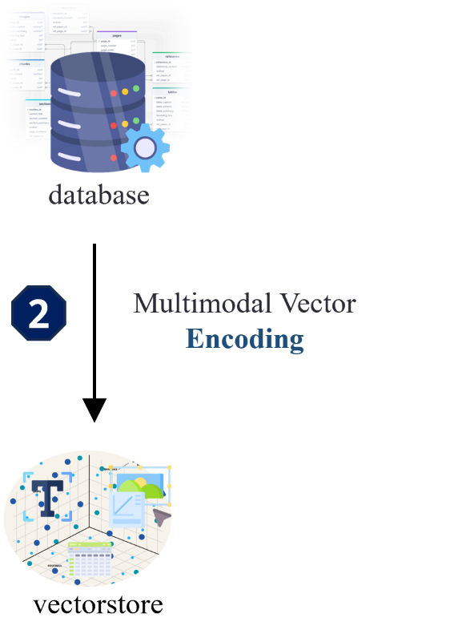
Method
Multimodal knowledge encoding
Phase 2：Multimodal Vector Encoding → vectorstore
Identify encodable columns
Apply modality-specific
models for encoding

Slide 7
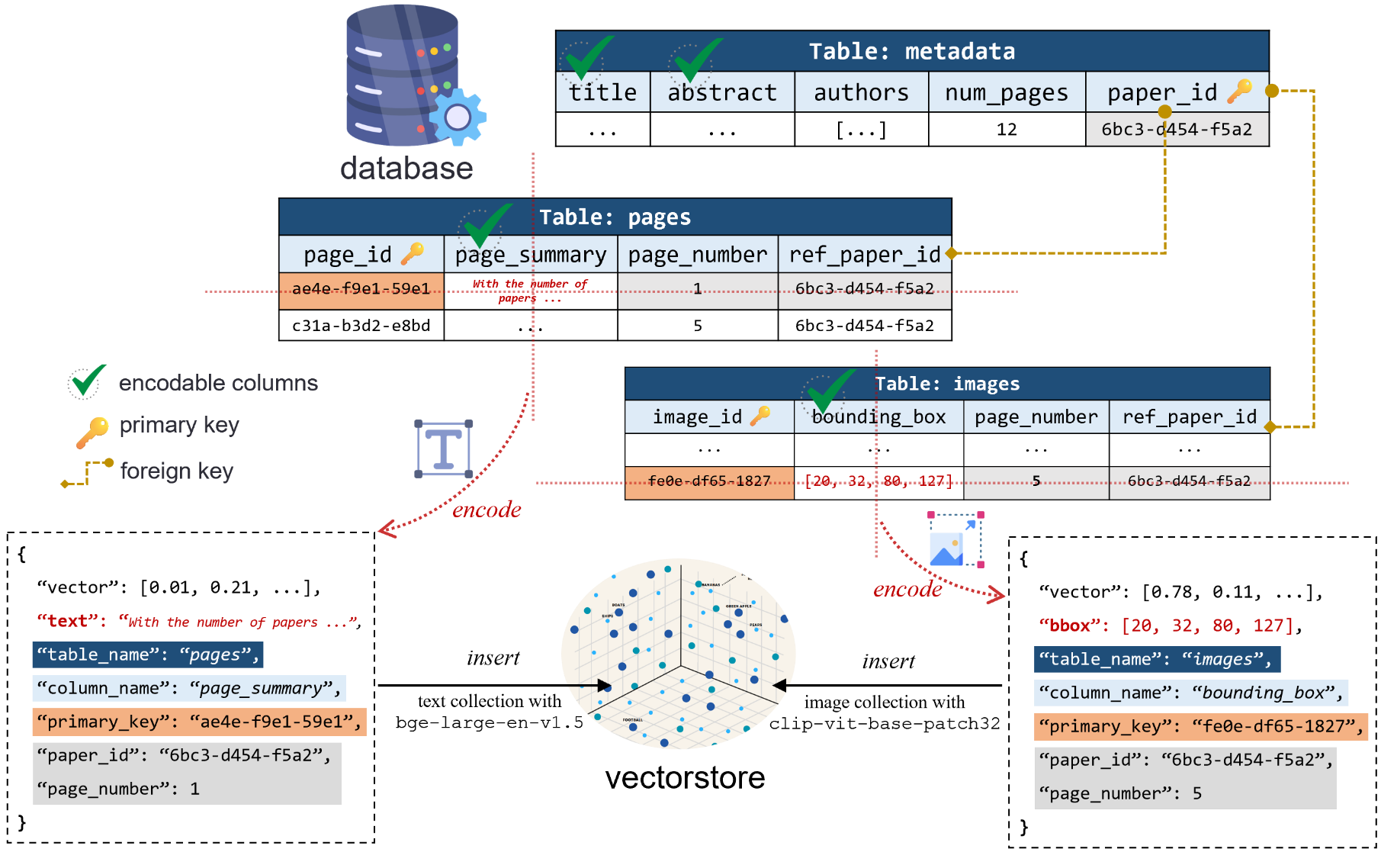
Method
Organization of heterogeneous knowledge sources
Identify encodable columns
Apply modality-specific models for encoding
Build mappings between the database and the vectorstore
Phase 2：Multimodal Vector Encoding → vectorstore
(table, column, primary_key)
Structured Indexing

Slide 8
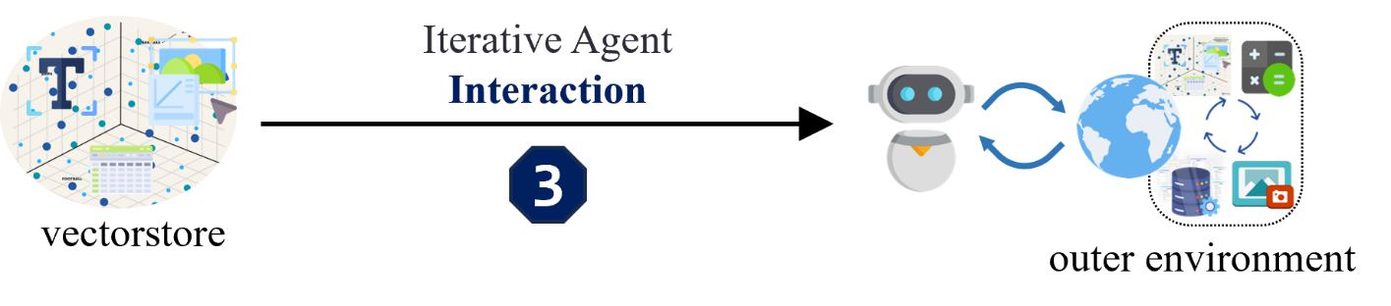
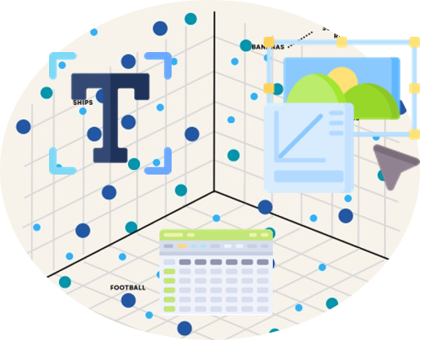
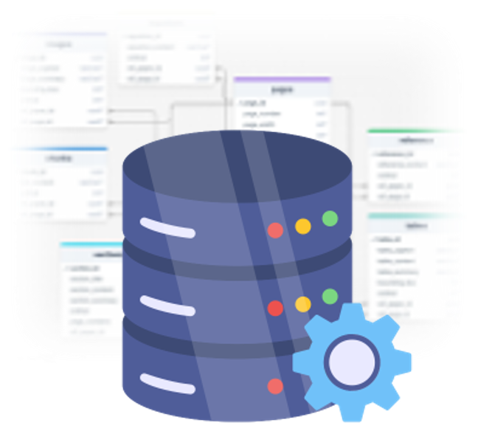

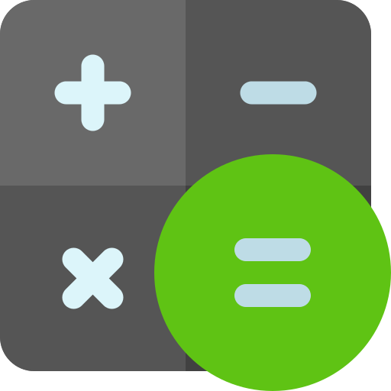


Method
Unified planning and scheduling of heterogeneous knowledge sources
Phase 3：Iterative Agent Interaction → outer environment
Composition of environment
heterogeneous knowledge sources
external tools
vectorstore
database
image viewer
calculator

Slide 9
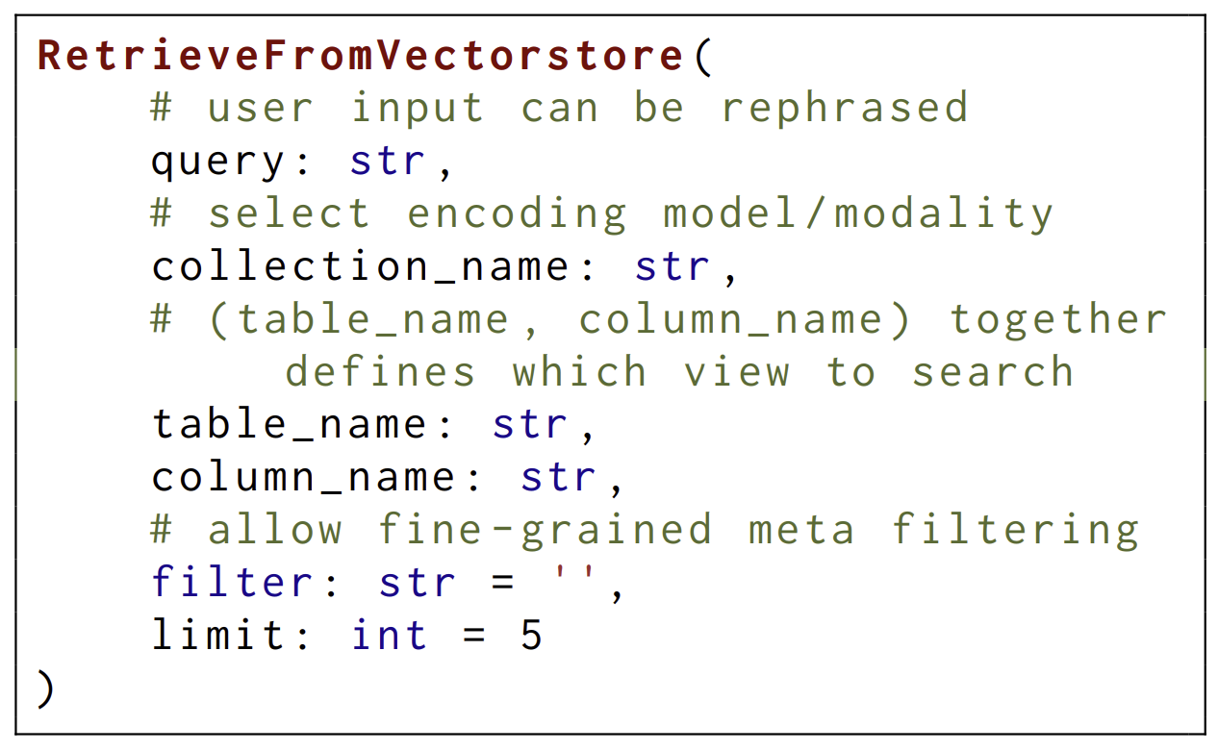
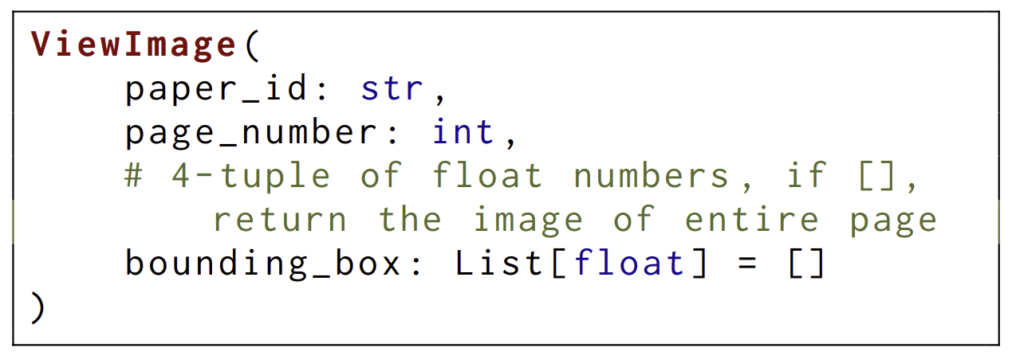
Method
Unified planning and scheduling of heterogeneous knowledge sources
Phase 3：Iterative Agent Interaction → outer environment
Composition of environment
heterogeneous knowledge sources
external tools
Interaction interface
unified action format
optional parameters

Slide 10
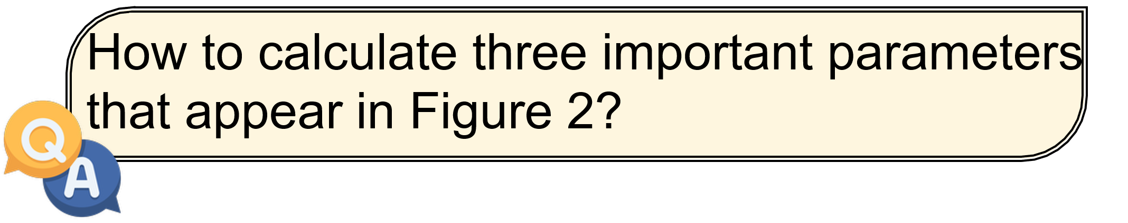
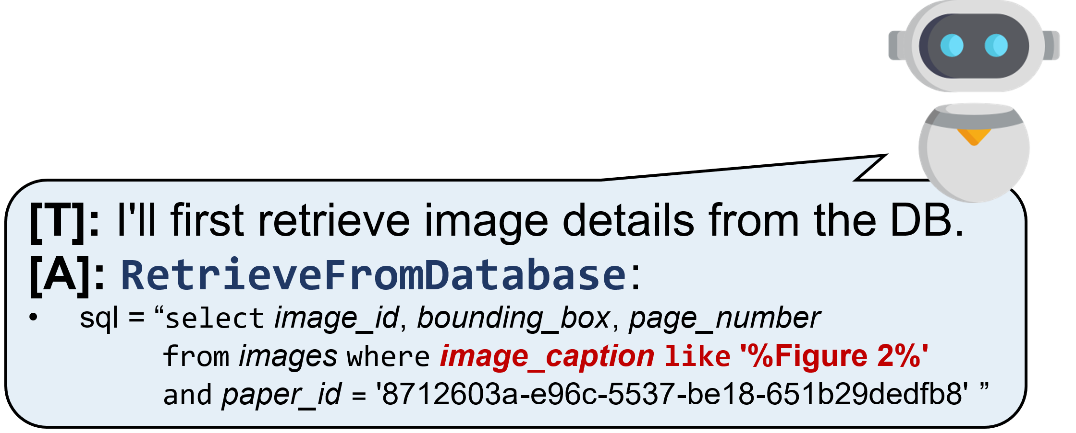
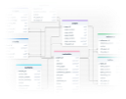


Method
Unified planning and scheduling of heterogeneous knowledge sources
Phase 3：Iterative Agent Interaction → outer environment
ReAct (Yao et al., 2023) Think before action ([T], [A], [O])
database
Iteration 1

Slide 11




Method
Unified planning and scheduling of heterogeneous knowledge sources
Phase 3：Iterative Agent Interaction → outer environment
ReAct (Yao et al., 2023) Think before action ([T], [A], [O])
[T]:
I will now view the image on that
page.
[A]:
ViewImage
:
•
paper_id
=
'8712603a
-
e96c
-
5537
-
be18
-
651b29dedfb8
'
•
page_number
=
image viewer
5
•
bounding_box
=
[69.0, 68.0, 527.0, 262.0]
[
O]
:
Iteration 2

Slide 12
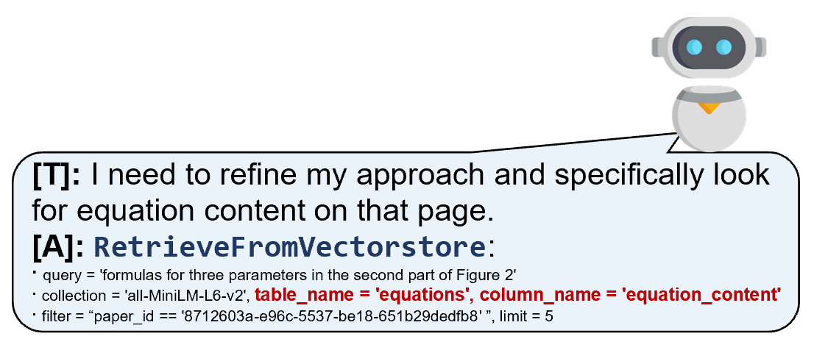
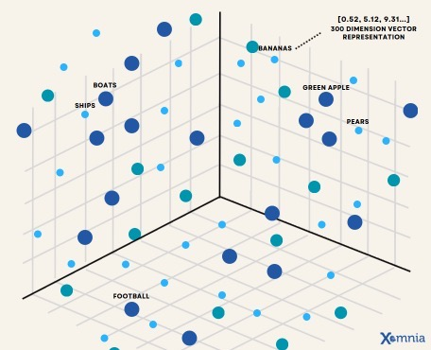



Method
Unified planning and scheduling of heterogeneous knowledge sources
Phase 3：Iterative Agent Interaction → outer environment
ReAct (Yao et al., 2023) Think before action ([T], [A], [O])
vectorstore
id
score
text
[
O]
:
1
0.3168
Iteration 3

Slide 13
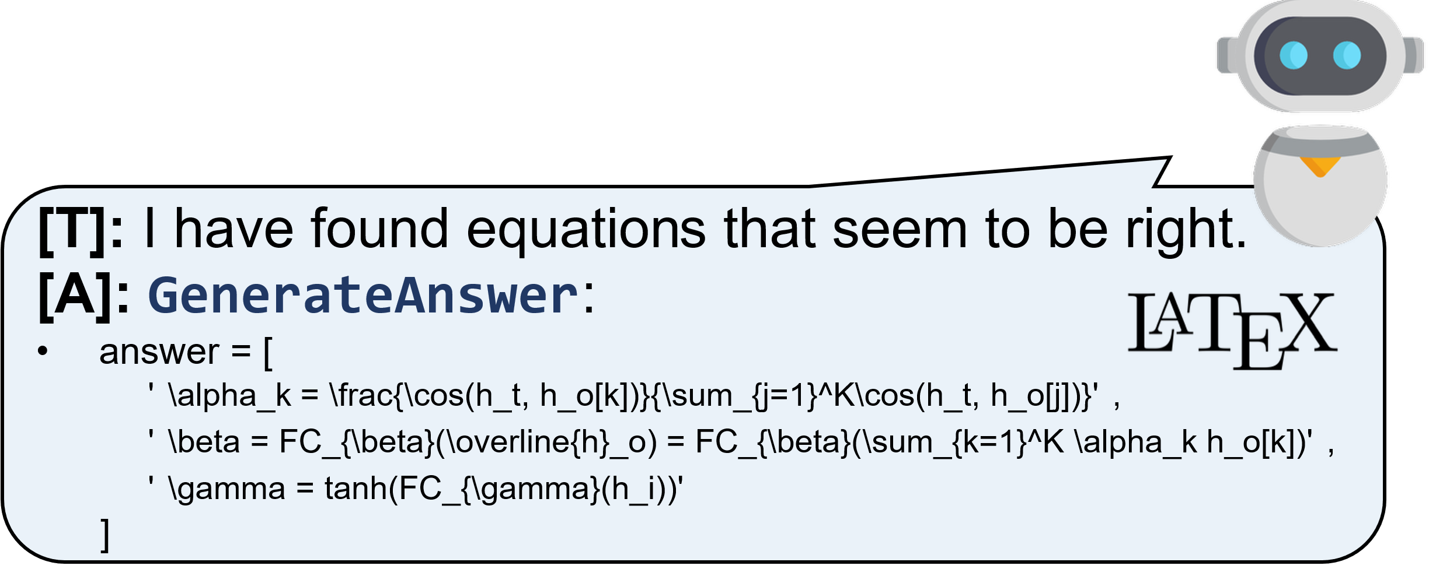

Method
Unified planning and scheduling of heterogeneous knowledge sources
Phase 3：Iterative Agent Interaction → outer environment
ReAct (Yao et al., 2023) Think before action ([T], [A], [O])
Iteration 4

Slide 14
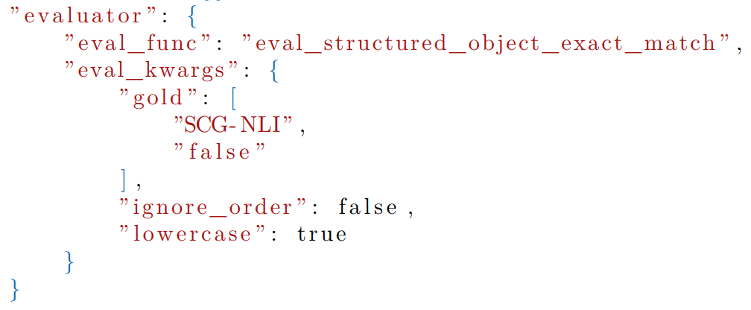
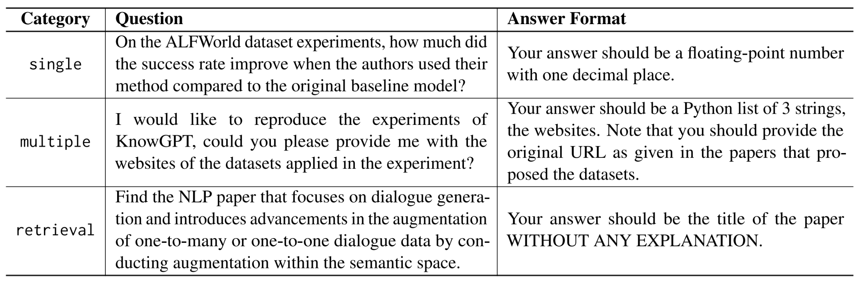
Experiment
PDF-based scholar QA datasets
Manually annotated AirQA-Real
3 question types + instance-specific evaluation + 553 examples
M3SciQA (﻿Li et al., 2024a) 和 SciDQA (﻿Singh et al., 2024)
objective evaluation function

Slide 15
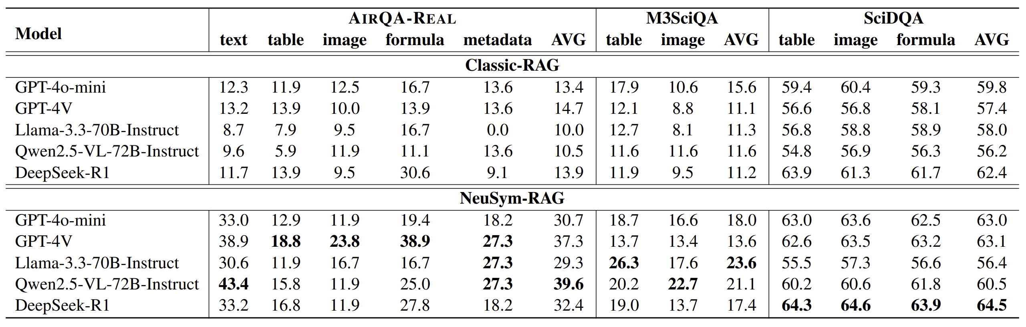
Experiment
Main experiment: different LLMs
﻿NeuSym-RAG remarkably outperforms Classic RAG on all three datasets.
﻿VLMs performs better in tasks that require vision capability.
﻿Open-source LLMs are capable of handling this complicated interactive procedure in a zeroshot paradigm, and even better than closed-source LLMs.

Slide 16
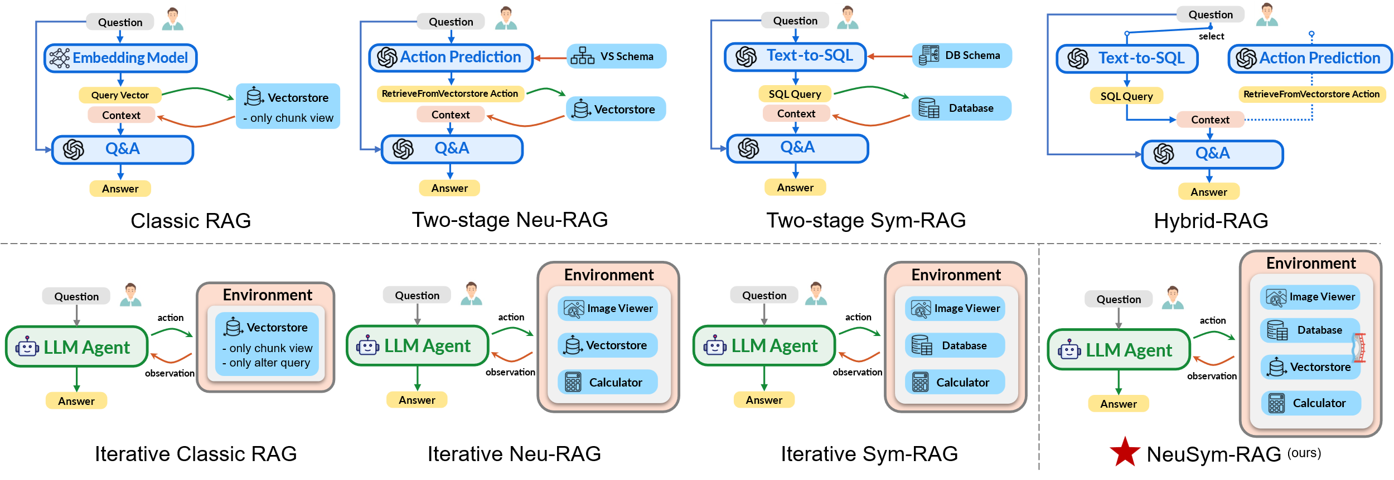
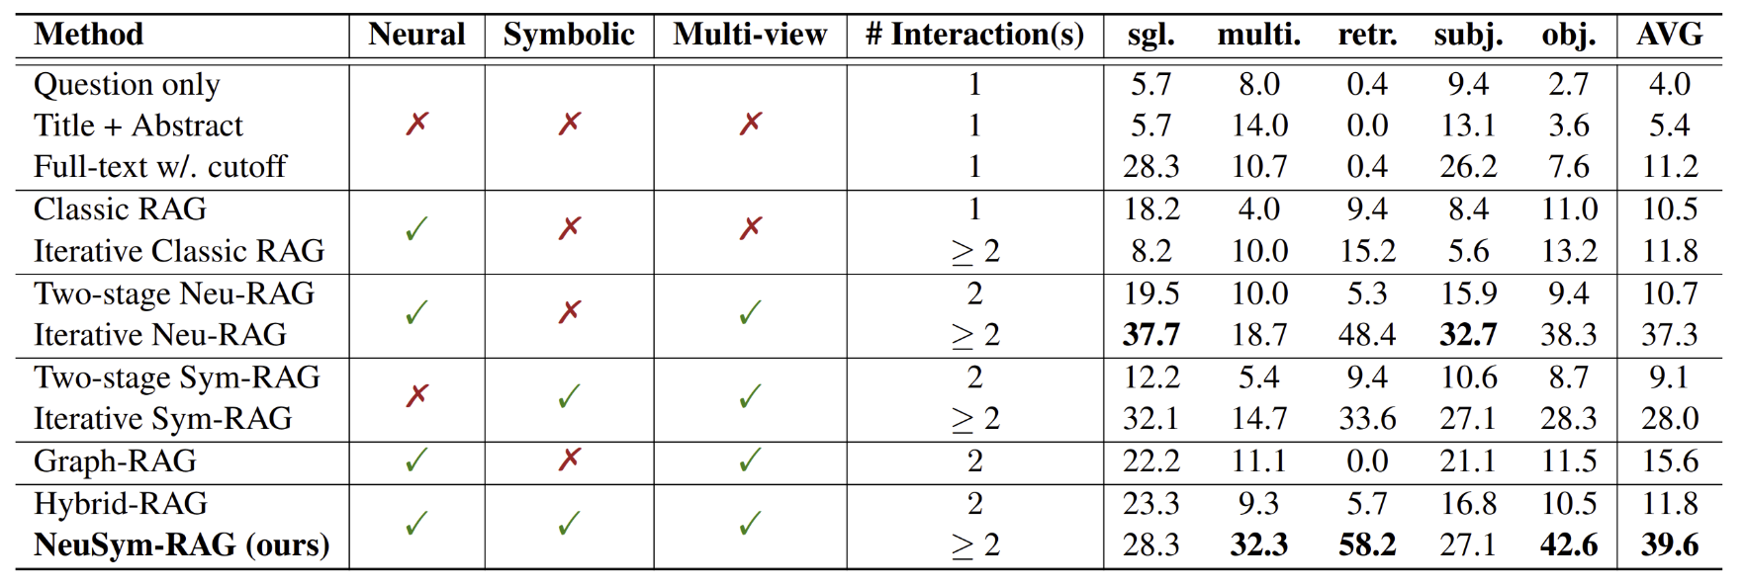
Experiment
Main experiment: different baselines
Symbolic/Neural?
Multi-view?
Iterative?
﻿﻿Two-stage Neu-RAG (multiview) beats Classic RAG.
Hybrid RAG (more views) improves further.
﻿﻿Iterative methods outperforms two-stage ones.
﻿﻿As turn increases, objective score rises faster.

Slide 17
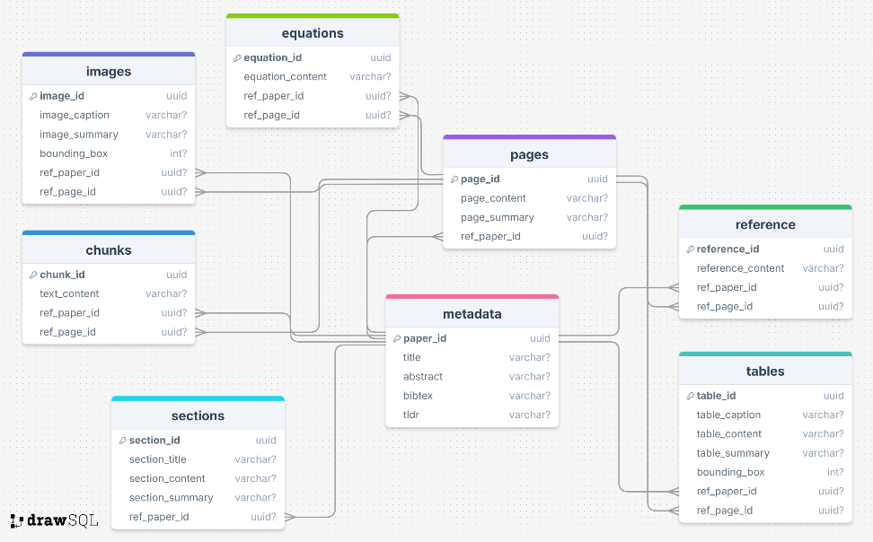
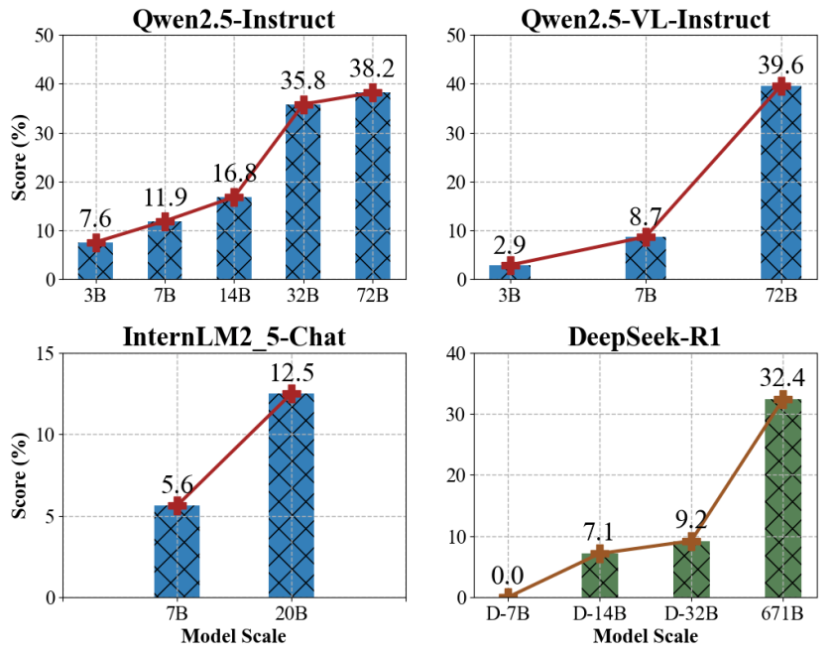
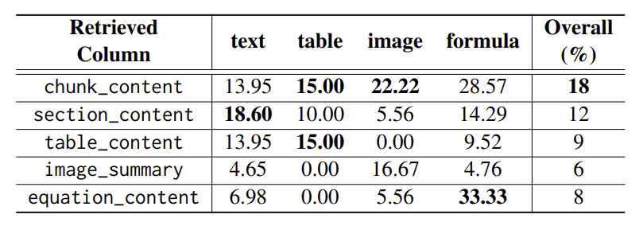
Experiment
Ablation study:
(table_name, column_name)
Different model size
Applying different views in Classic-RAG
﻿The performances consistently improve as the scales of LLMs increase.
﻿﻿The classic chunking strategy is still the best in general. However, chunking views tailored to specific aspects may achieve the best results in their particular categories.

Slide 18
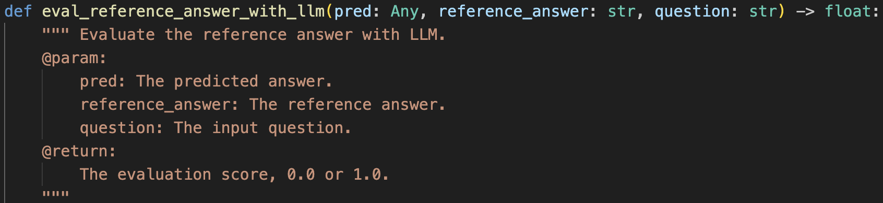
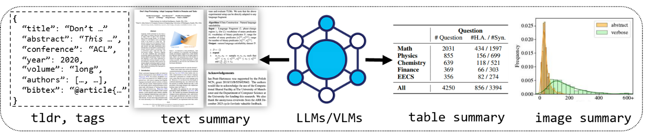
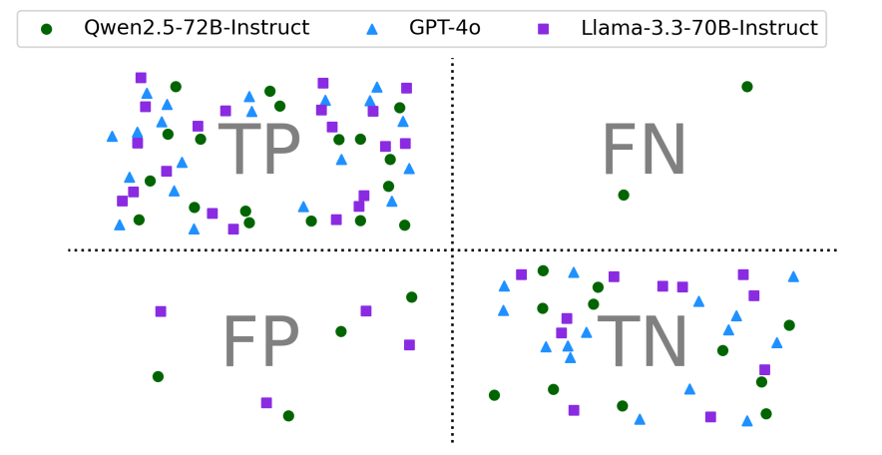
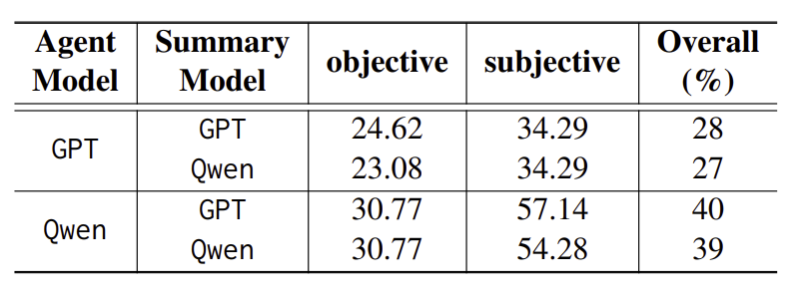
Experiment
Ablation study:
Different summary model
Consistency with human judgements
Summary generation: Open-source LLM appear to be a viable alternative to closed-source ones.
Subjective evalution: Closed-source LLM aligns better with human judgments.

